Slide 1
Moving advanced analytics to your SQL Server databases
Enrico van de Laar – Data Masterminds

Slide 5

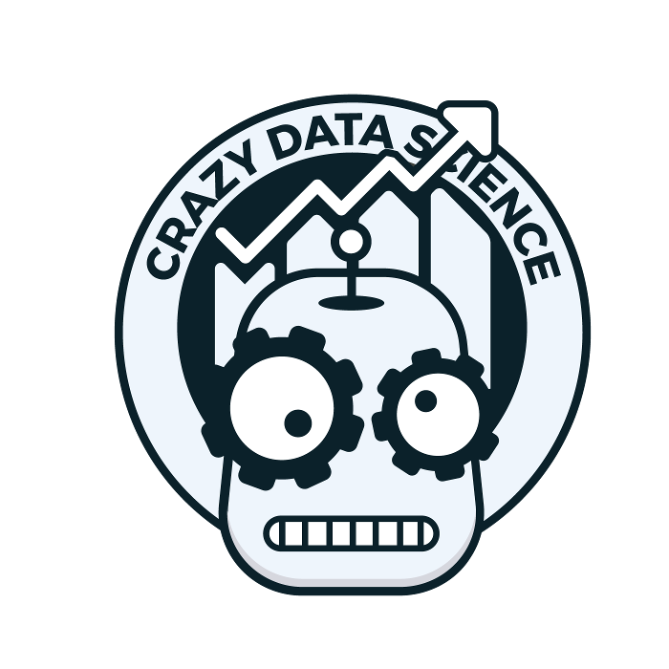
Enrico van de Laar
Microsoft Data Platform MVP
Author
Speaker
Blogger
Crazy Data Scientist
Consultant, Data Masterminds
/enrico-van-de-laar
@evdlaar

Slide 6
Plan for this session
Advanced Analytics workflow: then and now
Building and exploiting in-database models
(bonus) Azure Machine Learning integration

Slide 7
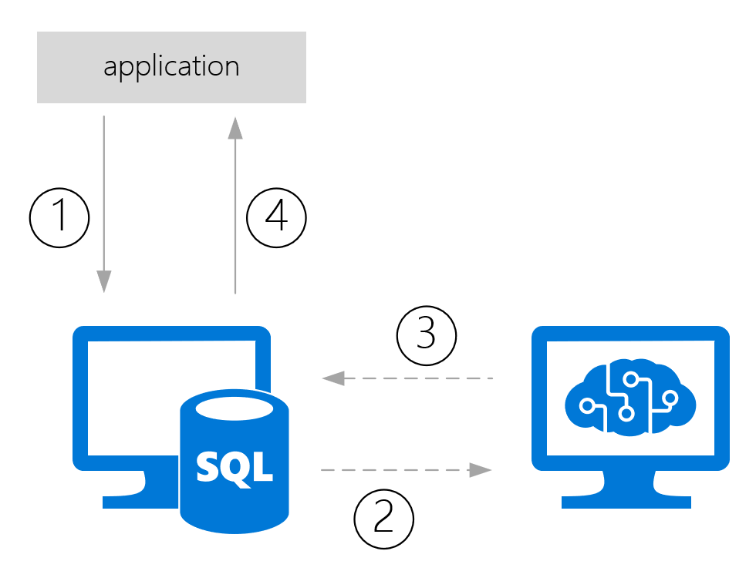
Advanced Analytics: then and now
Traditionally Advanced Analytics processes extracted data
That data would be used for model training/scoring and then send back to wherever it came from
Notes:
1: Data from app is stored in a database
2: Data is pushed/pulled to model
3: prediction is returned and stored with the data
4: prediction returned to app from database

Slide 8
Advanced Analytics: then and now
This process can be slow, especially when large datasets are involved
There is always data movement involved
How are we solving use-cases where (near) real-time scoring is required?
How are we handling model management and operationalization?

Slide 9
Traditional model scoring
Demo

Slide 10
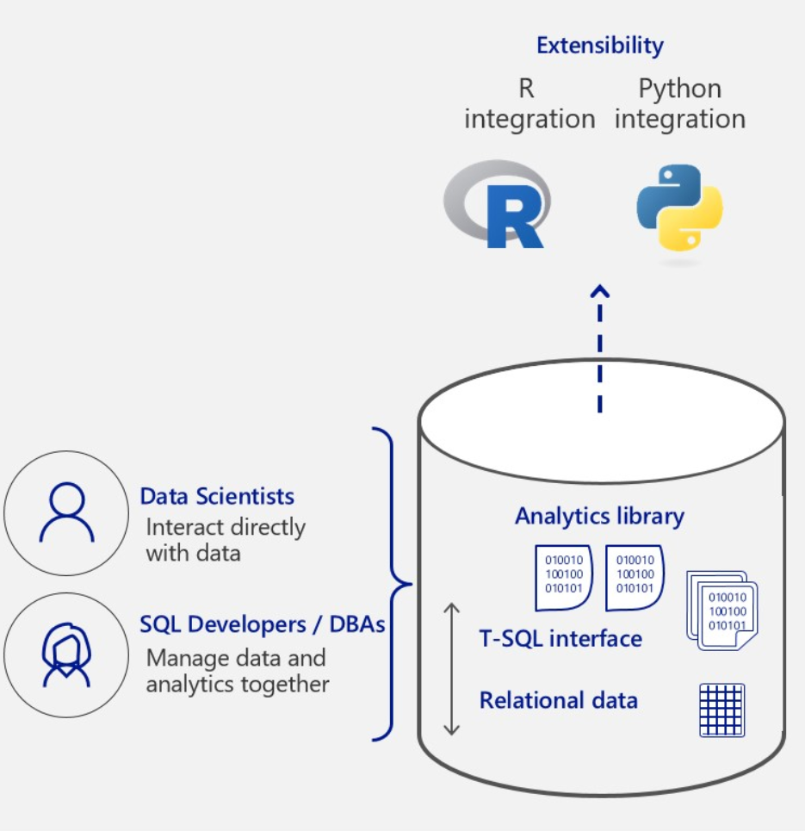
Advanced Analytics: then and now
The solution: “in-database” analytics
New feature in SQL Server 2016 (R Services In-database)
Expanded in SQL Server 2017 (Machine Learning Services In-database)
Improved in SQL Server 2019 (High-availability support)
Notes:
2016 Introduced R support
2017 Expanded with Python
2019 Introduced HA support for Machine Learning Services on a Windows Server Failover Cluster.
Advantages: No data movement, model management integrated in SQL Server, direct access to data

Slide 11
Building and exploiting in-db models
Three methods available for model training and scoring
sp_execute_external_script (SQL Server 2016)
sp_rxPredict (SQL Server 2016)
PREDICT (SQL Server 2017)

Slide 12
Building and exploiting in-db models
sp_execute_external_script
Supports both R and Python
Not dependent on RevoScaleR or MicrosoftML algorithms
External process
Requires in-database R or ML feature
sp_rxPredict
Fast!
Supports both R and Python (different .dll)
Requires CLR integration
Only supports RevoScaleR or MicrosoftML Algorithms
Only returns predictions
Requires in-database R or ML feature
PREDICT
Supports both R and Python
Fast
Easy TSQL integration
Does not requires in-database R or ML feature
Only SQL Server 2017
Only supports RevoScaleR algoritms

Slide 13
Building and exploiting in-db models
Let’s take a closer look at how sp_execute_external_script works
Source: https://docs.microsoft.com/en-us/sql/advanced-analytics/concepts/extension-r
Notes:
The proces is more or less the same for Python (with different .dll files)

Slide 14
Predicting Halloween survival
Demo
Notes:
Demo 1: Halloween survival

Slide 15
Azure Machine Learning integration
But what do you do when your model is stored inside Azure Machine Learning, but your data is on-premises inside a SQL Server database?
We can use sp_execute_external_script to write R/Python code to perform a call to the AzureML predictive experiment!

Slide 16
Integrating AzureML
Demo
Notes:
Demo 2: AzureML Integration

Slide 17
Summary
We looked at the Advanced Analytics workflow and how in-databases analytics can impact it;
Build and stored a model directly in SQL Server;
Used the various methods to exploit the model and perform in-database predictions;
Connected to an Azure Machine Learning predictive experiment to score data inside SQL Server.

Slide 18
Questions?

Slide 19
Learn more from Speaker Name
@evdlaar
enricovandelaar@datamasterminds.io

